Slide 1


RF Signals and Modulation

Slide 2
RF Signals and Modulation
“RF Signals and Modulation”: This chapter covers the basic theory behind radio frequency (RF) signals and the methods used to carry data wirelessly.
Welcome to the world of Cisco Certified Network Associate (CCNA) Wireless! As technology continues to evolve, wireless technologies are finding their way to the forefront. This clearly indicates the progression from a fixed wired type of connectivity to a more fluid, mobile workforce that can work when, where, and how they want.
Cisco Wireless Certiﬁcations in the Real World
Cisco has one of the most recognized names on the Internet. Cisco Certified wireless
specialists can bring quite a bit of knowledge to the table because of their deep
understanding of wireless technologies, standards, and networking devices. This is why
the Cisco certification carries such high respect in the marketplace. Cisco certifications
demonstrate to potential employers and contract holders a certain professionalism,
expertise, and dedication required to complete a difficult goal. If Cisco certifications
were easy to obtain, everyone would have them.

Slide 3
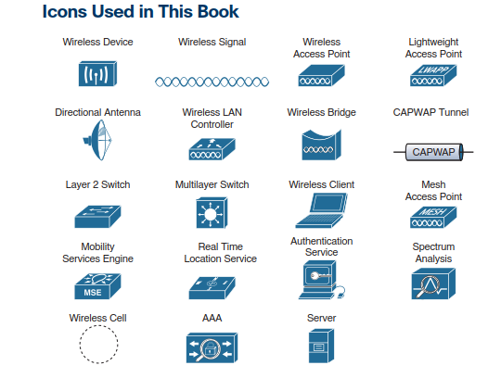

Slide 4
Command Syntax Conventions
The conventions used to present command syntax in this book are the same conventions used in the IOS Command Reference. The Command Reference describes these conventions as follows:
■ Boldface indicates commands and keywords that are entered literally as shown. In
actual configuration examples and output (not general command syntax), boldface
indicates commands that are manually input by the user (such as a show command).
■ Italic indicates arguments for which you supply actual values.
■ Vertical bars (|) separate alternative, mutually exclusive elements.
■ Square brackets ([ ]) indicate an optional element.
■ Braces ({ }) indicate a required choice.
■ Braces within brackets ([{ }]) indicate a required choice within an optional element.

Slide 5
1 Comparing Wired and Wireless Networks
A- In a wired network,
1- any two devices that need to communicate with each other must be connected by a wire.
2-The “wire” might contain strands of metal or fiber optic material that run continuously from one end to the other.
3- Data that passes over the wire is bounded by the physical properties of the wire.
4- The IEEE 802.3 set of standards defines strict guidelines for the Ethernet wire itself.
B- In Wireless data
1- Wireless data must travel through free space, without the constraints and protection of a
wire.
2- In the free space environment, many variables can affect the data and its delivery. To
minimize the variables, wireless engineering efforts must focus on two things:
Wireless devices must adhere تلتزمto a common standard.
Wireless coverage must exist in the area where devices are expected.
Wireless LANs are based on the IEEE 802.11 standard,

Slide 6
2 Understanding Basic Wireless Theory
To send data across a wired link, an electrical signal is applied at one end and is carried to the other end.
A wireless link has no physical strands of anything to carry the signal along.

Slide 7
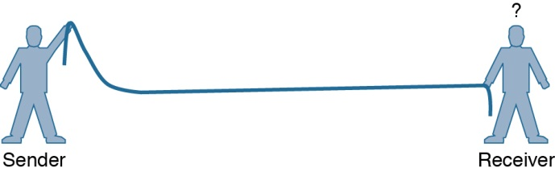
How then can an electrical signal be sent across the air, or free space? Consider a simple analogy of two people standing far apart, and one person wants to signal something to other. They are connected by a long and somewhat-loose رخوrope;
Figure 3-1 shows the end result; the rope falls back down after a tiny distance, and the receiver never notices a change.
Figure 3-1 Failed Attempt to Pass a Message Down a Rope

Slide 8
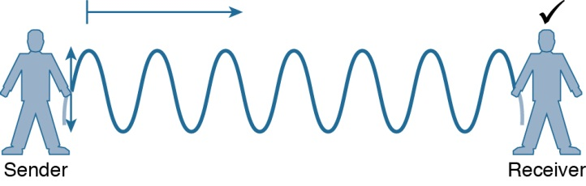
The sender tries a different strategy. He cannot push the rope, but when he begins to wave it up and down in a steady, regular motion, a curious طريف thing happens. A continuous wave pattern appears along the entire length of the rope, as shown in Figure 3-2
(each representing one up and down cycle of the sender’s arm) actually travel from the
sender to the receiver.
Figure 3-2 Sending a Continuous Wave Down a Rope

Slide 9
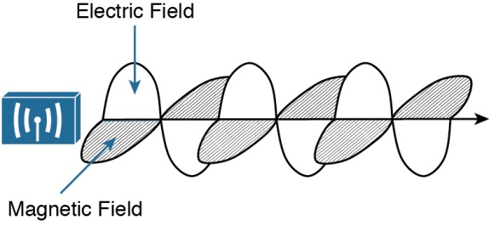
In free space, a similar principle occurs.
1- The sender (a transmitter) can send an alternating current into a section of wire (an antenna), which sets up moving electric and magnetic fields(electromagnetic waves) that propagate out and away as traveling waves.
2- The electric and magnetic fields travel along together and are always at right angles to each other, as shown in Figure 1-3. The signal must keep changing, or alternating, by cycling up and down, to keep the electric and magnetic fields cycling and pushing ever outward.
Figure 1-3 Traveling Electric and Magnetic Waves

Slide 10
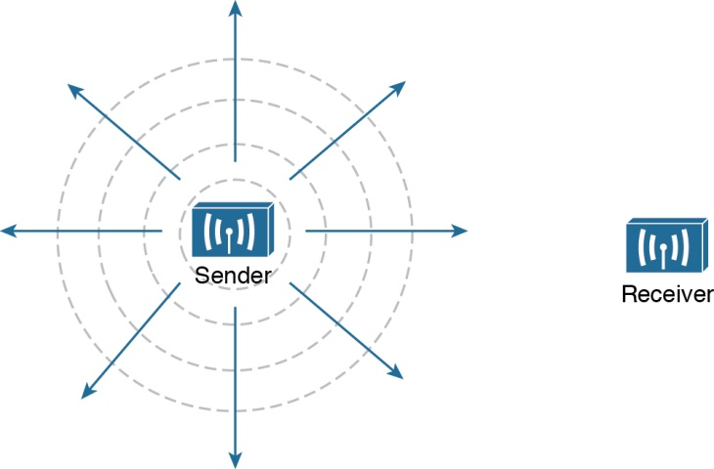
1- Electromagnetic waves do not travel in a straight line. Instead, they travel by expanding in all directions away from the antenna
2- In free space, the electromagnetic waves expand outward in all three dimensions.
At the receiving end of a wireless link, the process is reversed. As the electromagnetic waves reach the receiver’s antenna, they induce an electrical signal. If everything works right, the received signal will be a reasonable copy of the original transmitted signal.
Figure 1-4 Wave Propagation with an Idealistic Antenna

Slide 11
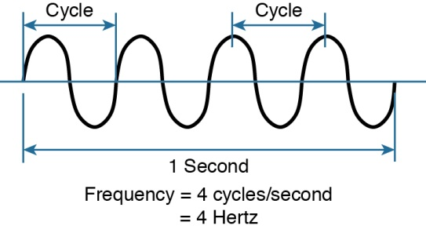
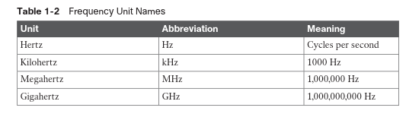
3 Understanding Frequency
Frequency is: the number of times the signal makes one complete up and down cycle in 1 second.
Figure 1-5 Cycles Within a Wave

Slide 12
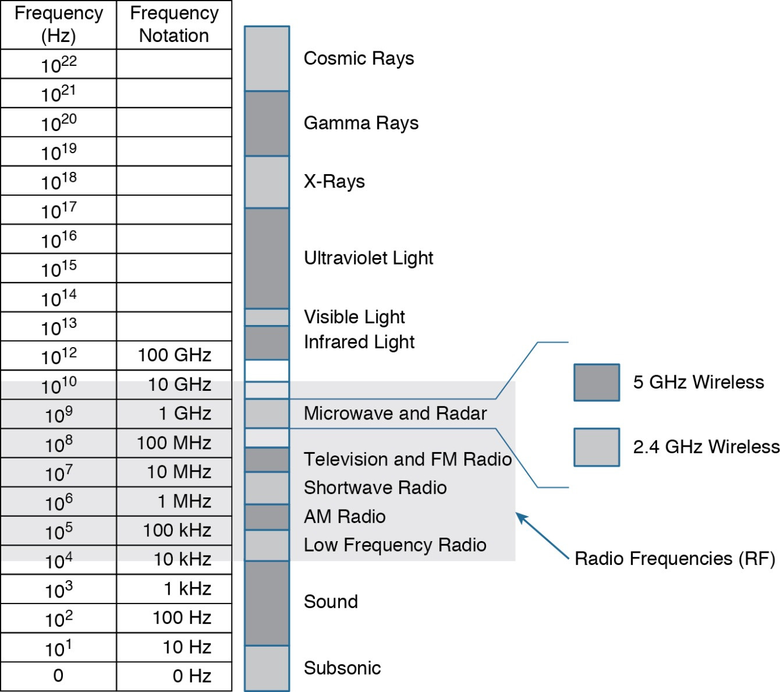
One of the two main frequency ranges used for wireless LAN communication lies between 2.400 and 2.4835 GHz. This is usually called the 2.4-GHz band,
The other wireless LAN range is usually called the 5-GHz band
Figure 1-6 Continuous Frequency Spectrum

Slide 13
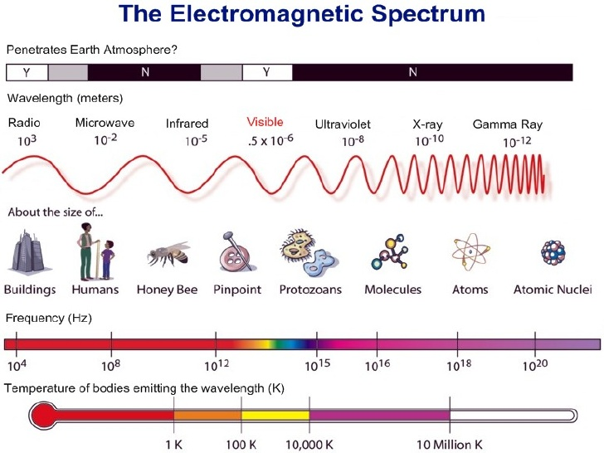
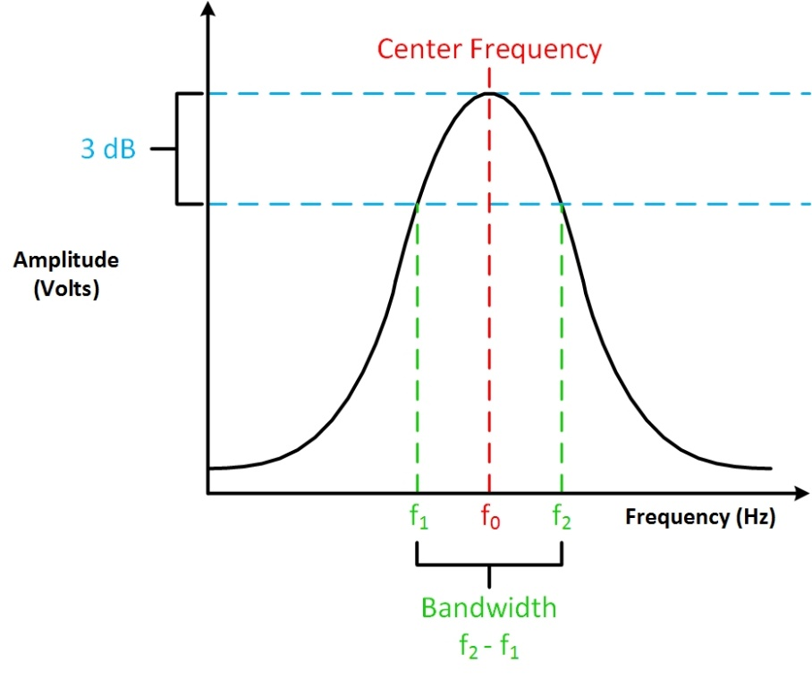
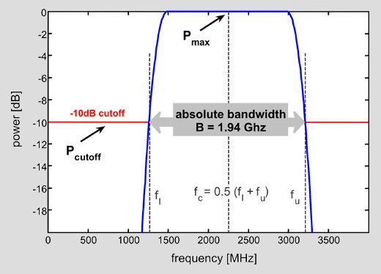
bandwidth
Bandwidth: is the difference between the upper and lower frequencies in a continuous set of frequencies.

Slide 14
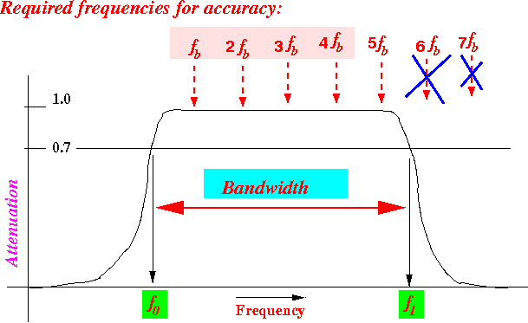

Slide 15
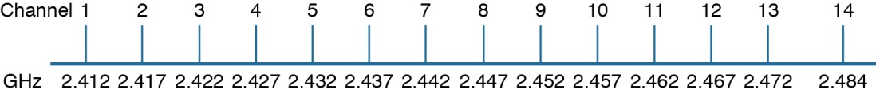
To keep everything orderly and compatible, bands are usually divided up into a number of distinct channels. Each channel is known by a channel number and is assigned to a specific frequency. As long as the channels are defined by a national or international standards body, they can be used consistently in all locations.
Figure 1-7 Example of Channel Spacing in the 2.4-GHz Band

Slide 16
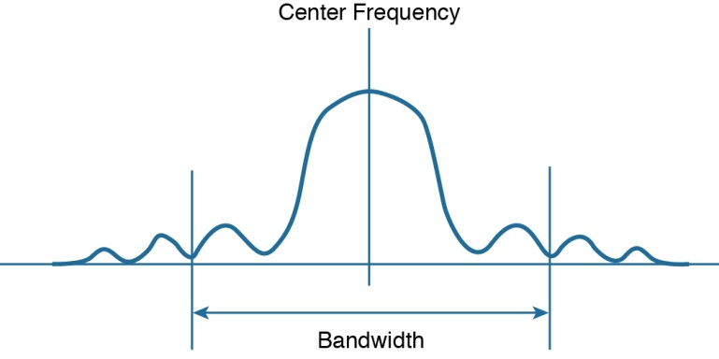
In wireless LANs, the signal bandwidth is defined as part of a standard. Even though the signal might extend farther above and below the center frequency than the bandwidth allows, wireless devices will use something called a spectral mask to ignore parts of the signal that fall outside the bandwidth boundaries.
Figure 1-8 Signal Bandwidth

Slide 17
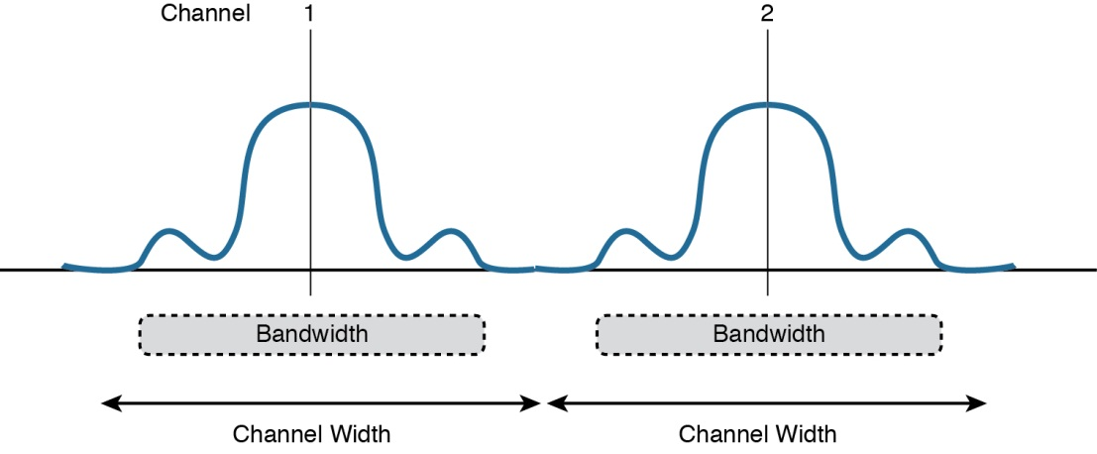
Ideally, the signal bandwidth should be less than the channel width so that a different signal
could be transmitted on every possible channel with no chance that two signals could overlap and interfere with each other. Figure 1-9 shows such a channel spacing, where the signals
on adjacent channels do not overlap. A signal can exist on every possible channel without
overlapping with others.
Figure 1-9 Non-overlapping Channel Spacing

Slide 18
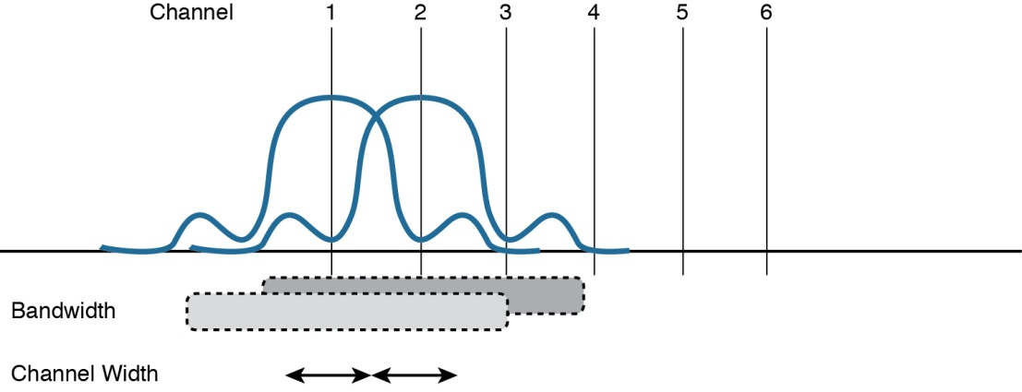
It is entirely possible that the channels in a band are narrower than the signal bandwidth, as shown in Figure 1-10
but they almost entirely overlap each other! The problem is that the signal bandwidth is slightly wider than four channels. In this case, signals centered on adjacent channels cannot possibly coexist without overlapping and interfering. Instead, the signals must be placed on more distant channels to prevent overlapping, thus limiting the number of channels that can be used in the band.
only the newer signals might require more bandwidth than the original channel numbering supported. Such is the case with the 2.4-GHz Wi-Fi band.
Figure 1-10 Overlapping Channel Spacing

Slide 19
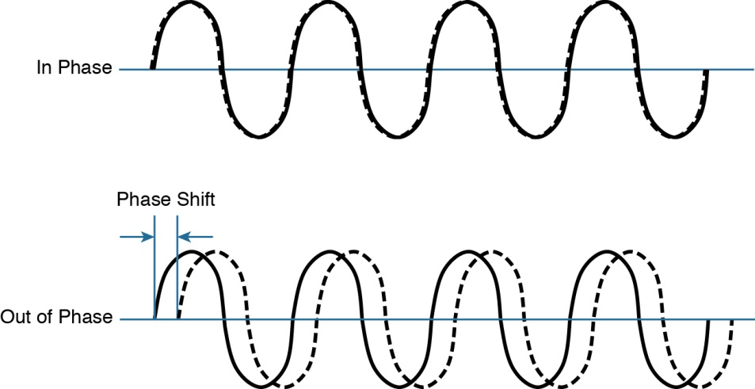
1.4 Understanding Phase
RF signals are very dependent upon timing because they are always in motion.
the signals are made up of electrical and magnetic forces that vary over time
When two identical signals are produced at exactly the same time, their cycles match up and they are said to be in phase with each other.
If one signal is delayed from the other, the
two signals are said to be out of phase
Figure 1-11 Signals In and Out of Phase

Slide 20
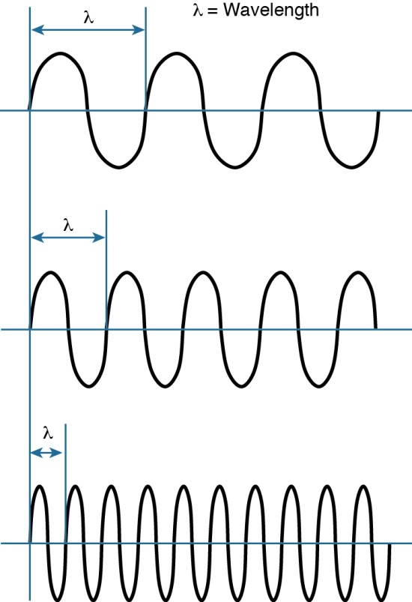
1.5 Measuring Wavelength
RF signals are usually described by their frequency;
The wavelength is a measure of the physical distance that a wave travels over one complete cycle
Wavelength is usually designated by the Greek symbol lambda (λ).
a 2.4-GHz signal would have a wavelength of 4.92 inches,
while a 5-GHz signal would be 2.36 inches.
Figure 1-12 Examples of Increasing Frequency and Decreasing Wavelength

Slide 21
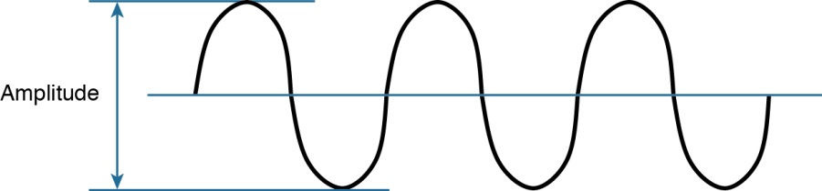
1.6 Understanding RF Power and dB
This strength can be measured as the amplitude, or the height from the top peak to the bottom peak of the signal’s waveform, as shown in Figure 1-13.
Figure 1-13 Signal Amplitude
The strength of an RF signal is usually measured by its power, in watts (W). For example, a typical AM radio station broadcasts at a power of 50,000 W; an FM radio station might use 100,000 W. In comparison, a wireless LAN transmitter usually has a signal strength between 0.1 W (100 mW) and 0.001 W (1 mW).
When power is measured in watts or milliwatts, it is considered to be an absolute power
measurement.

Slide 22
Frequency, Spectrum and Bandwidth
Time Domain Concepts
analog signal
signal intensity varies smoothly with no breaks
digital signal
signal intensity maintains a constant level and then abruptly changes to another level
periodic signal
signal pattern repeats over time
aperiodic signal
pattern not repeated over time
Notes:
Frequency, Spectrum, and Bandwidth
In this book, we are concerned with electromagnetic signals used as a means to transmit data. At point 3 in Figure 1.5, a signal is generated by the transmitter and transmitted over a medium. The signal is a function of time, but it can also be expressed as a function of frequency; that is, the signal consists of components of different frequencies. It turns out that the frequency domain view of a signal is more important to an understanding of data transmission than a time domain view. Both views are introduced here.
Time Domain Concepts
Viewed as a function of time, an electromagnetic signal can be either analog or digital. An analog signal is one in which the signal intensity varies in a smooth, or continuous, fashion over time. In other words, there are no breaks or discontinuities in the signal. A digital signal is one in which the signal intensity maintains a constant level for some period of time and then abruptly changes to another constant level, in a discrete fashion. Stalling DCC9e Figure 3.1 shows an example of each kind of signal. The analog signal might represent speech, and the digital signal might represent binary 1s and 0s.
The simplest sort of signal is a periodic signal, in which the same signal pattern repeats over time. Stallings DDC9e Figure 3.2 shows an example of a periodic continuous signal (sine wave) and a periodic discrete signal (square wave). Mathematically, a signal s(t) is defined to be periodic if and only if
s(t + T) = s(t) –∞ < t < +∞
where the constant T is the period of the signal (T is the smallest value that satisfies the equation). Otherwise, a signal is aperiodic.
A mathematical definition: a signal s(t) is continuous if for all a.
This is an idealized definition. In fact, the transition from one voltage level to another will not be instantaneous, but there will be a small transition period. Nevertheless, an actual digital signal approximates closely the ideal model of constant voltage levels with instantaneous transitions.

Slide 23
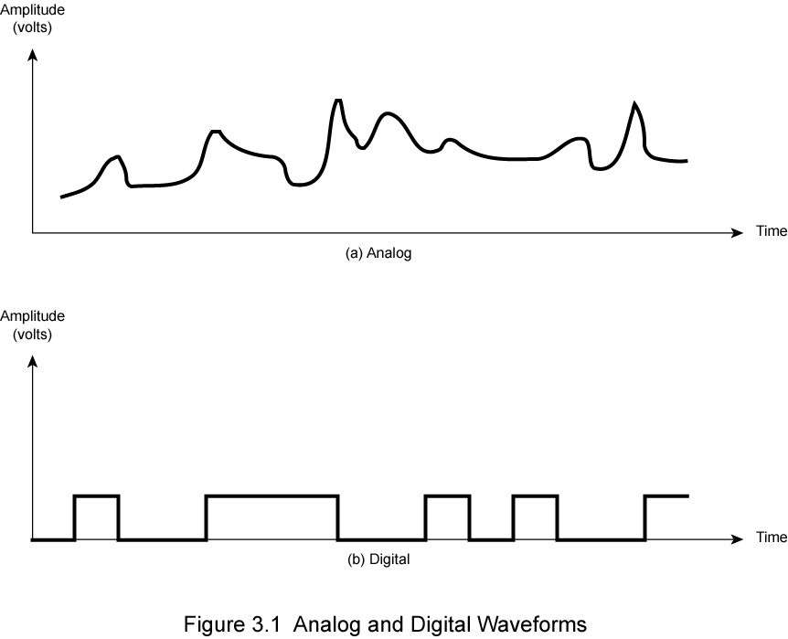
Analog and Digital Signals
Notes:
Figure 3.1 shows an example of both analog or digital signals. The continuous signal might represent speech, and the discrete signal might represent binary 1s and 0s.

Slide 24
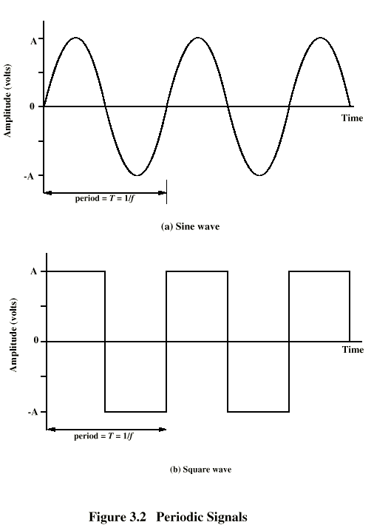
Periodic Signals
Notes:
In Figure 3.2 a signal is generated by the transmitter and transmitted over a medium. The signal is a function of time, but it can also be expressed as a function of frequency; that is, the signal consists of components of different frequencies. It turns out that the frequency domain view of a signal is more important to an understanding of data transmission than a time domain view. Both views are introduced here.

Slide 25
Sine Wave
(periodic continuous signal)
peak amplitude (A)
maximum strength of signal
typically measured in volts
frequency (f)
rate at which the signal repeats
Hertz (Hz) or cycles per second
period (T) is the amount of time for one repetition
T = 1/f
phase (φ)
relative position in time within a single period of signal
Notes:
The sine wave is the fundamental periodic signal. A general sine wave can be represented by three parameters: peak amplitude (A), frequency (f), and phase (f). The peak amplitude is the maximum value or strength of the signal over time; typically, this value is measured in volts. The frequency is the rate [in cycles per second, or hertz (Hz)] at which the signal repeats. An equivalent parameter is the period (T) of a signal, which is the amount of time it takes for one repetition; therefore, T = 1/f. Phase is a measure of the relative position in time within a single period of a signal, as is illustrated subsequently. More formally, for a periodic signal f(t), phase is the fractional part t/T of the period T through which t has advanced relative to an arbitrary origin. The origin is usually taken as the last previous passage through zero from the negative to the positive direction.

Slide 26
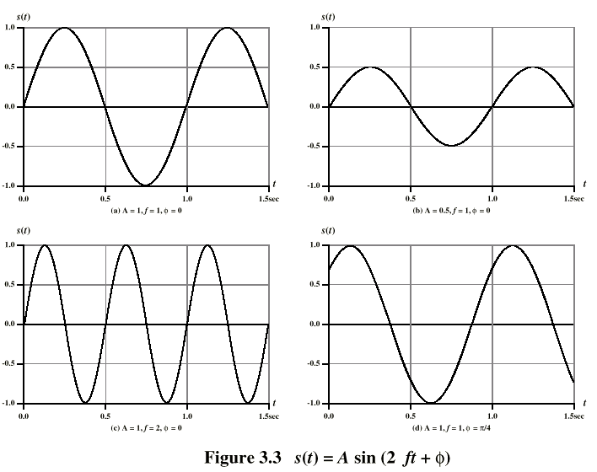
Varying Sine Waves s(t) = A sin(2πft +Φ)
Notes:
The general sine wave can be written
s(t) = A sin(2πft + f)
A function with the form of the preceding equation is known as a sinusoid. Figure 3.3 shows the effect of varying each of the three parameters. In part (a) of the figure, the frequency is 1 Hz; thus the period is T = 1 second. Part (b) has the same frequency and phase but a peak amplitude of 0.5. In part (c) we have f = 2, which is equivalent to T = 0.5. Finally, part (d) shows the effect of a phase shift of π/4 radians, which is 45 degrees (2π radians = 360˚ = 1 period).
In Figure 3.3, the horizontal axis is time; the graphs display the value of a signal at a given point in space as a function of time. These same graphs, with a change of scale, can apply with horizontal axes in space. In this case, the graphs display the value of a signal at a given point in time as a function of distance. For example, for a sinusoidal transmission (e.g., an electromagnetic radio wave some distance from a radio antenna, or sound some distance from a loudspeaker), at a particular instant of time, the intensity of the signal varies in a sinusoidal way as a function of distance from the source.

Slide 27
Science - Transmission of Sound
https://youtu.be/GkNJvZINSEY
Fourier Transform, Fourier Series, and frequency spectrum
https://youtu.be/r18Gi8lSkfM

